Slide 1
DS 6373 -Time Series
Unit 12-Live Session Assignment
Business Sales Forecasting

Slide 2
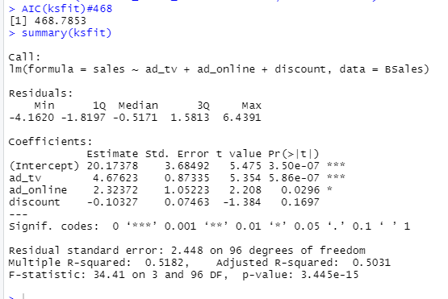

Business Sales-Model--Statistical Significance-Initial-p<0.05

Slide 3
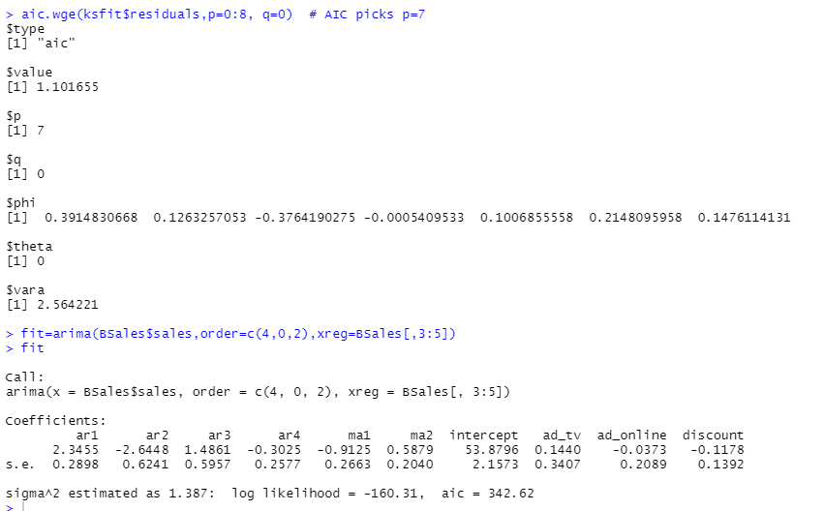
Business Sales-Model-1-ARIMA is p=7,q=0

Slide 4
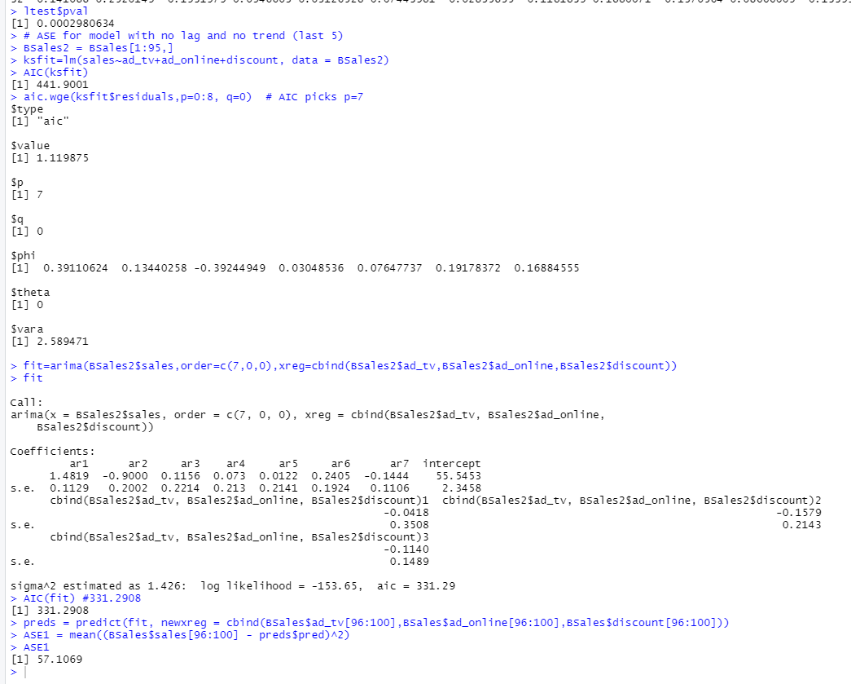
Business Sales –Model 1 AIC-441/ASE-57.10

Slide 5
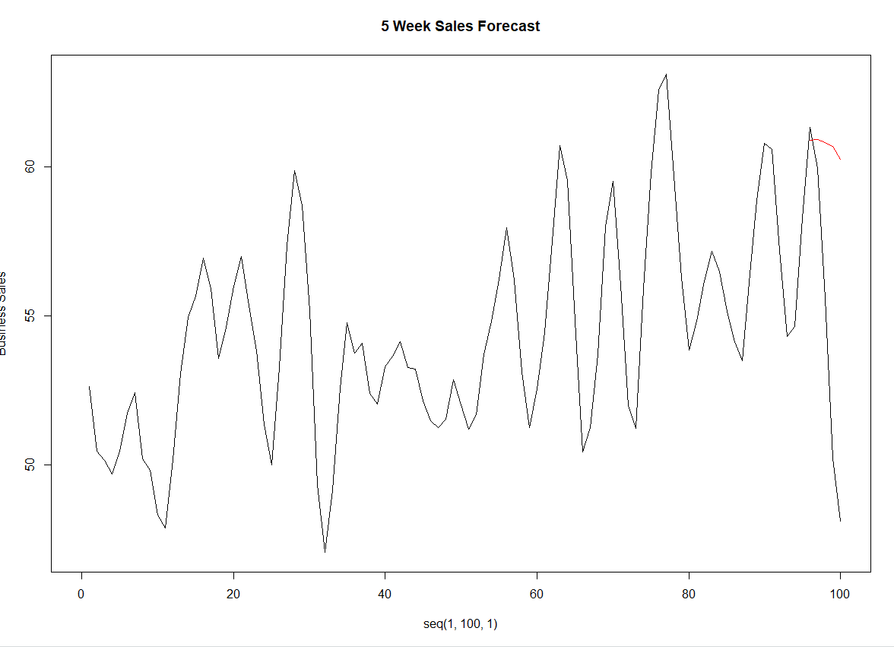
Business Sales-Model 1-5 weeks Forecast

Slide 6
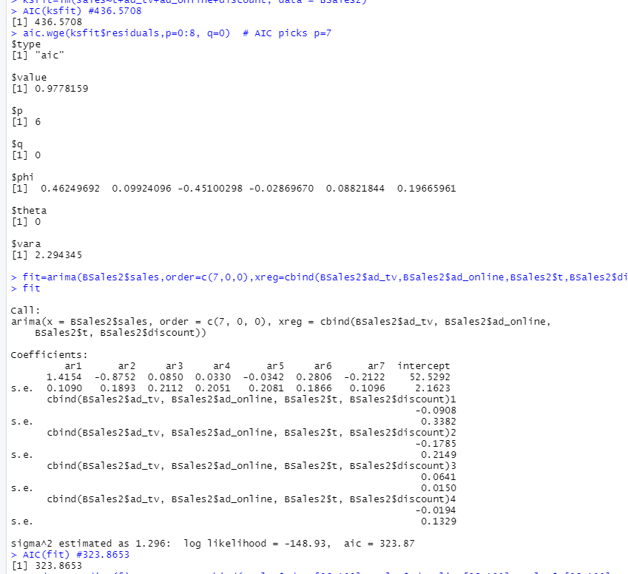
Business Sales-Mode2-1-ARIMA is p=6,q=0

Slide 7
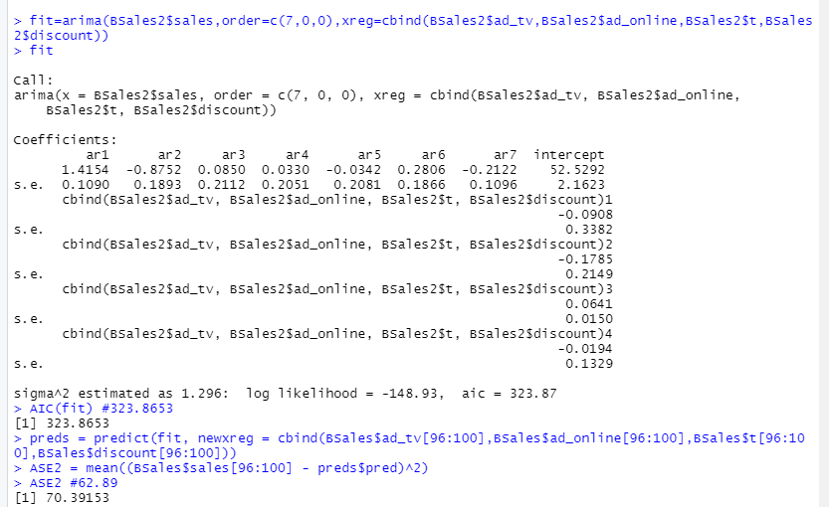
Business Sales –Mode2 -Trend AIC-323/ASE-70.4

Slide 8
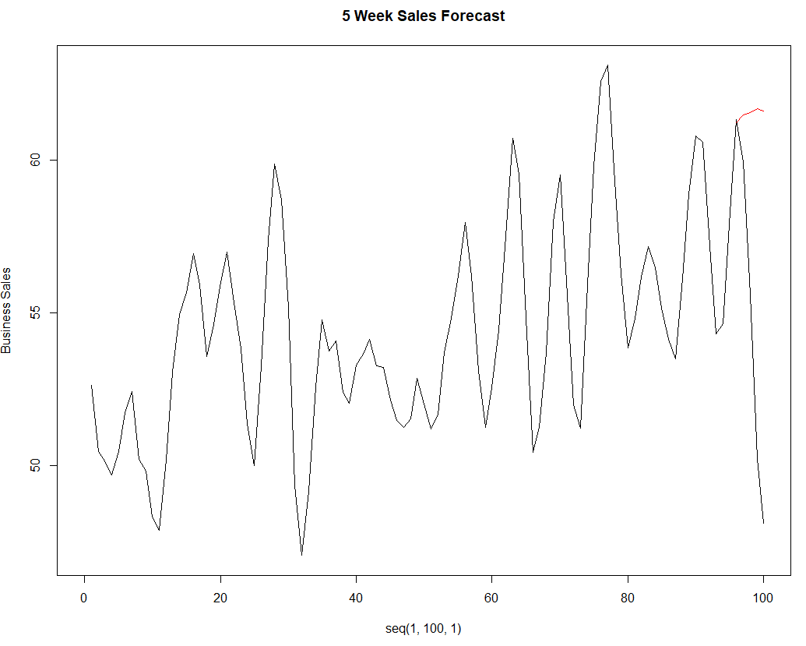
Business Sales-Model-2- 1-5 weeks Forecast

Slide 9
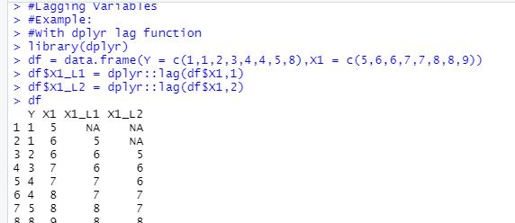
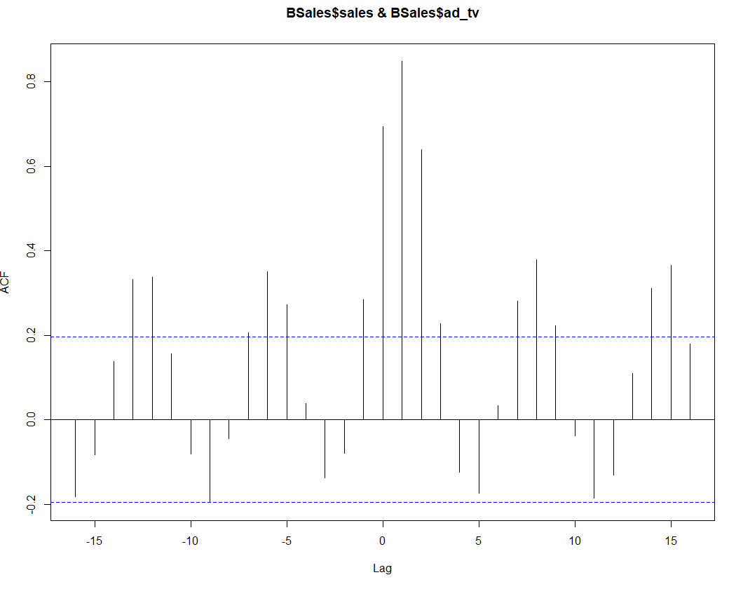
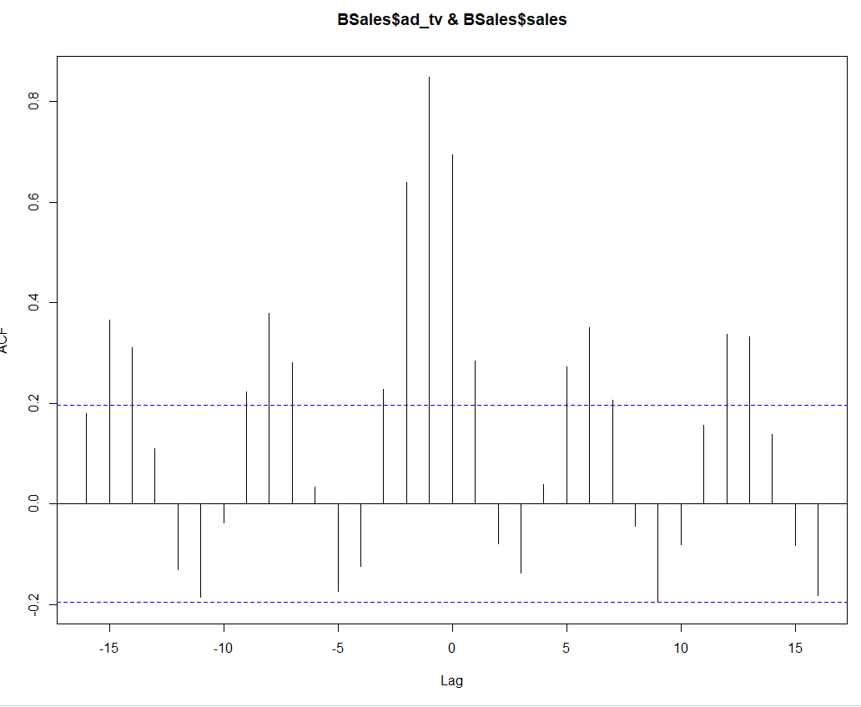
Business Sales-with Lag/CCF

Slide 10
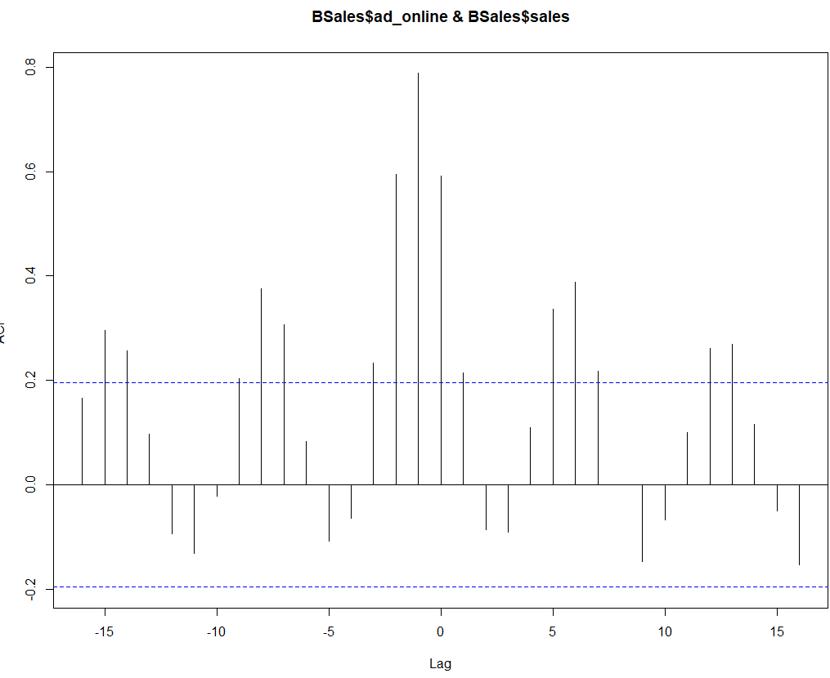
Business Sales-with Lag/CCF

Slide 11
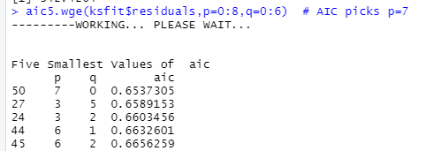
Business Sales-Mode3-1-ARIMA is p=7,q=0

Slide 12
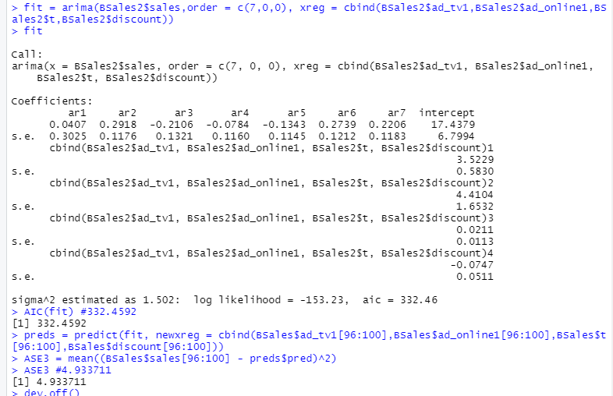
Business Sales –Mode3 –Lag/Trend AIC-332/ASE-4.94

Slide 13
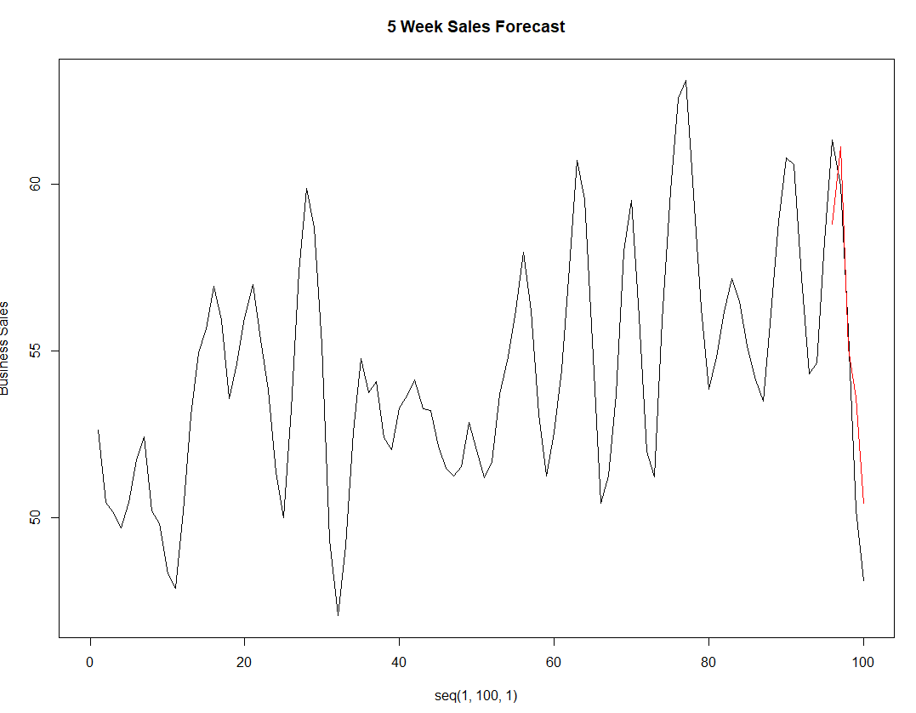
Business Sales-Model-3-Lag/Trend-TV-Ad 1-5 weeks Forecast

Slide 14
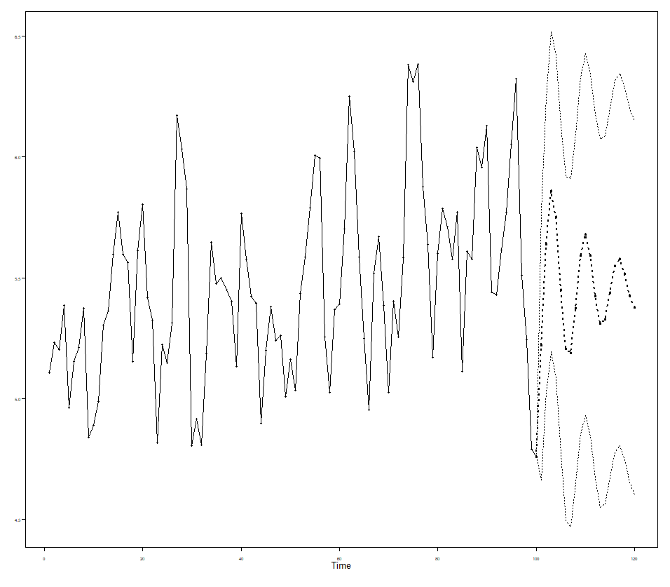
Business Sales-TVAd Forecast-5 weeks Forecast

Slide 15
Business Sales-TVAd Forecast-5 weeks Forecast

Slide 16
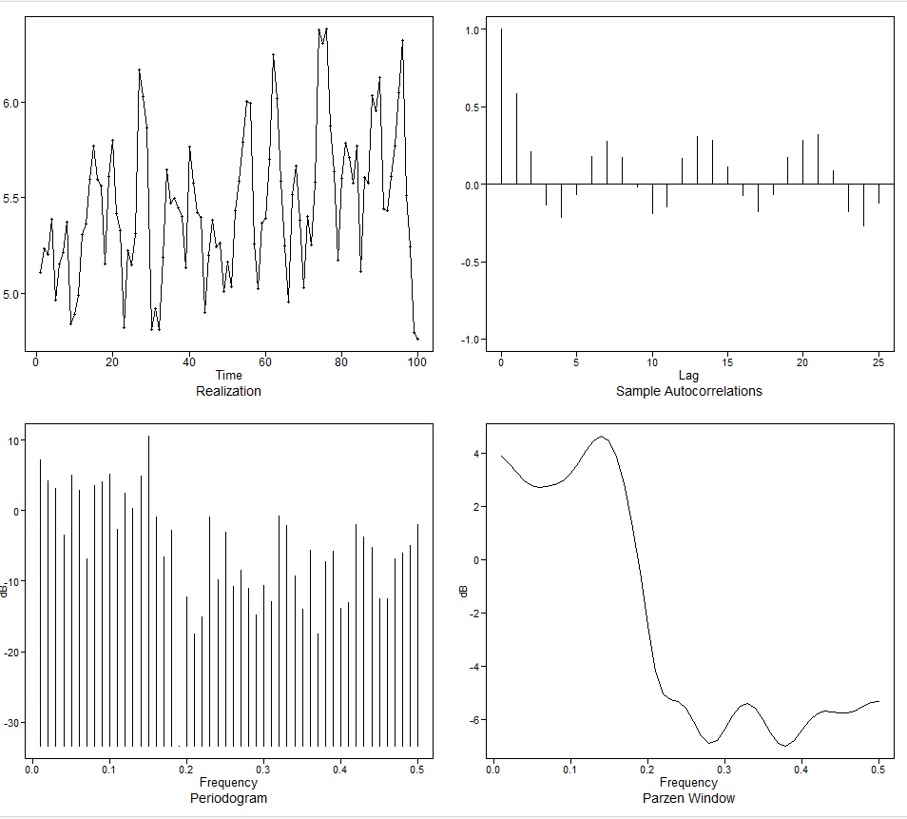
Business Sales-TVAd-Features

Slide 17
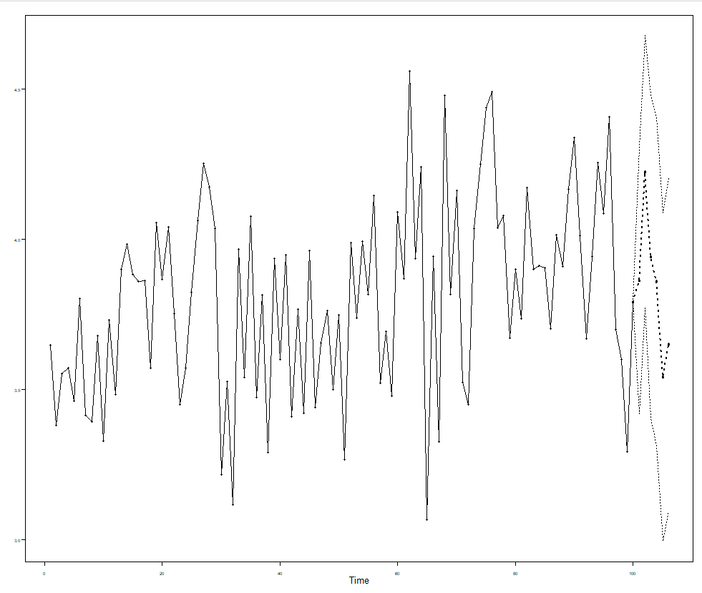
Business Sales-Online Forecast-5 weeks Forecast

Slide 18
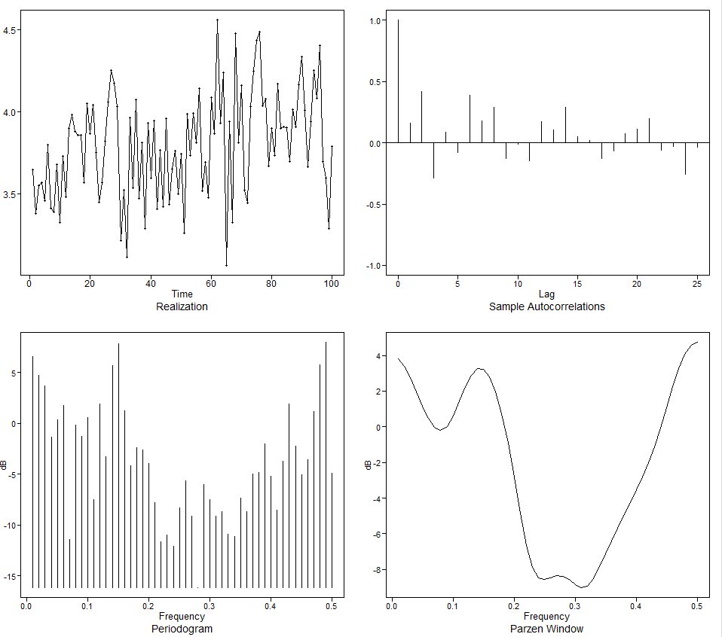
Business Sales-Online-Features

Slide 19
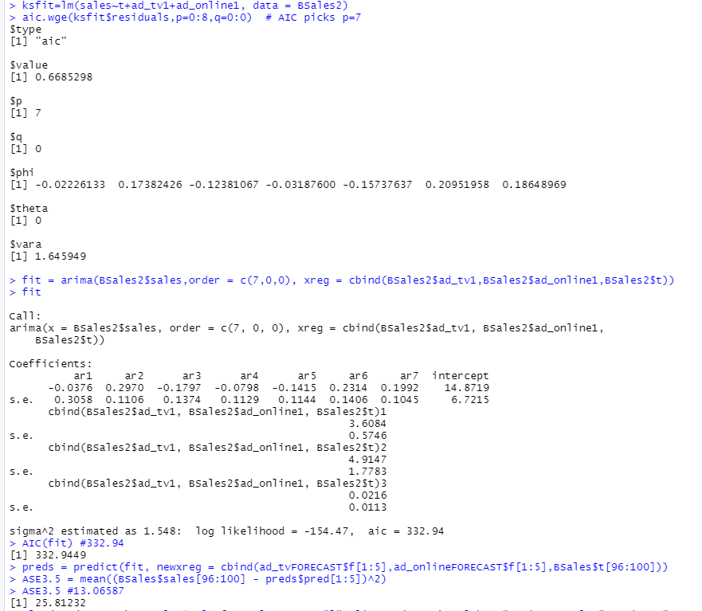
Business Sales –Mode3 –no Lag/Trend AIC-332/ASE-25 p=7,q=0

Slide 20
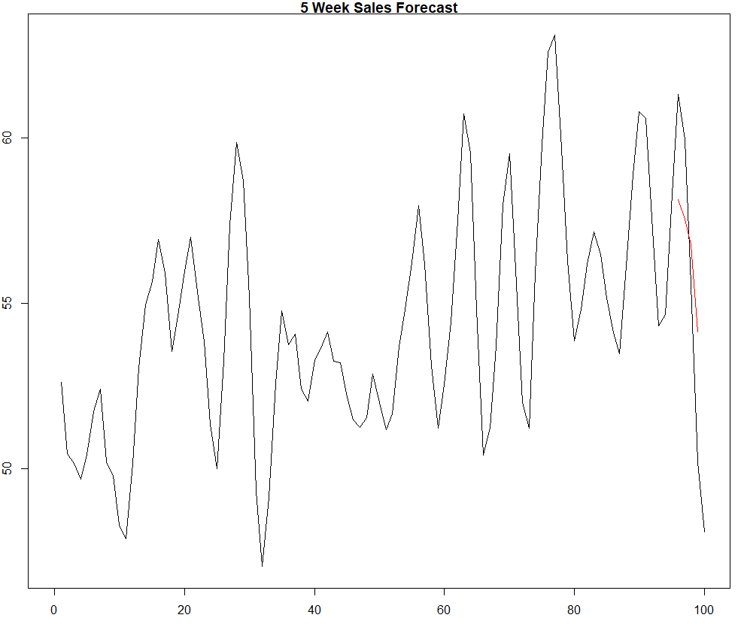
Business Sales-no lag/trend Forecast-5 weeks Forecast

Slide 21
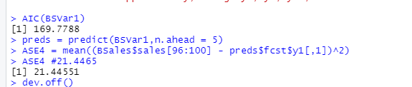
Var Model-4

Slide 22
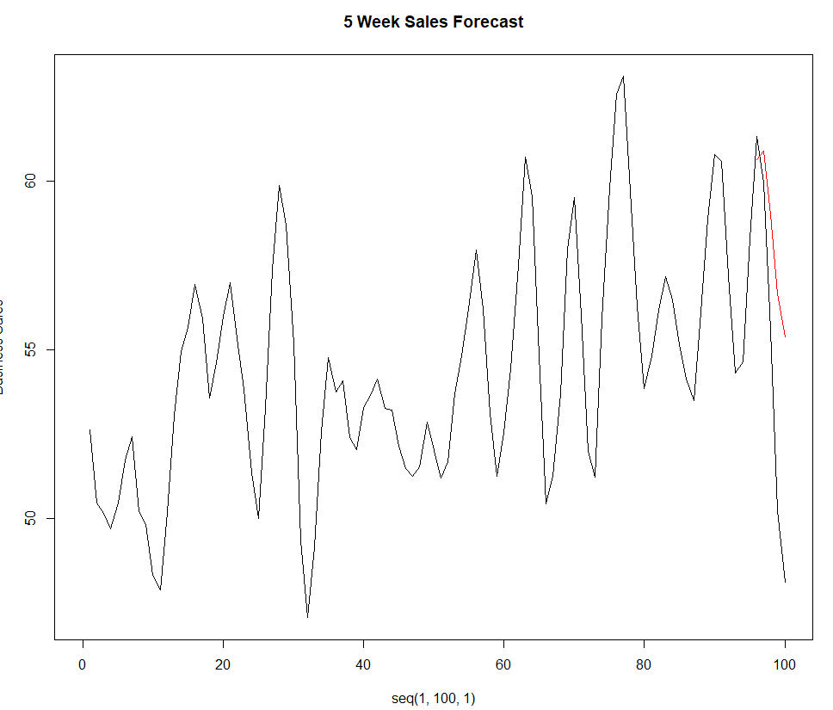
Var Model-4

Slide 23
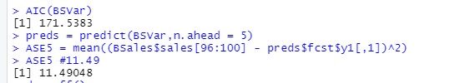
Var Model-5-no trend

Slide 24
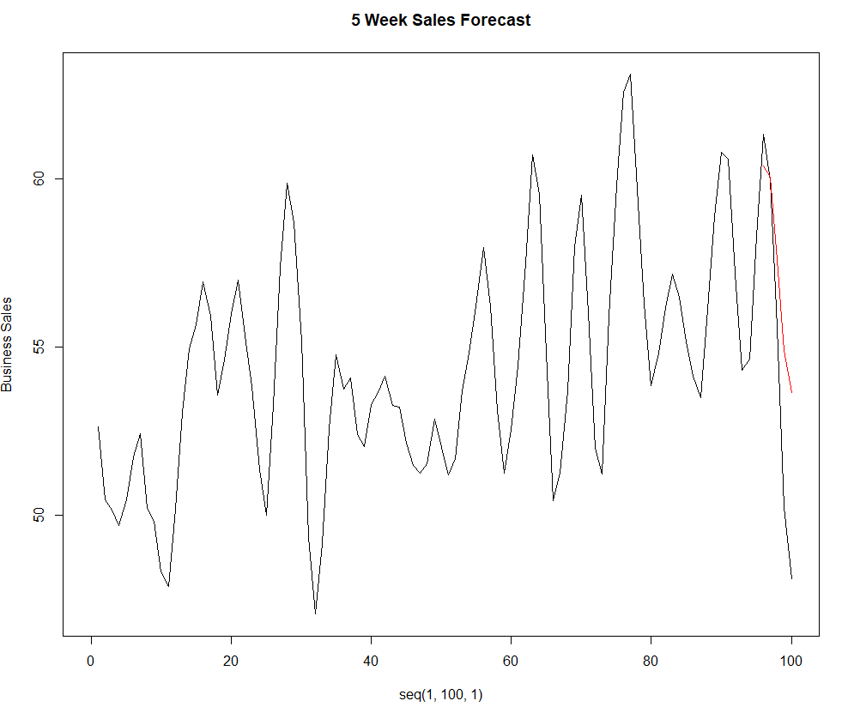
Var Model-5-no trend

Slide 25
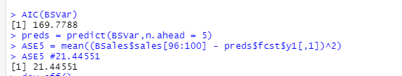
Var Model-6-trend

Slide 26
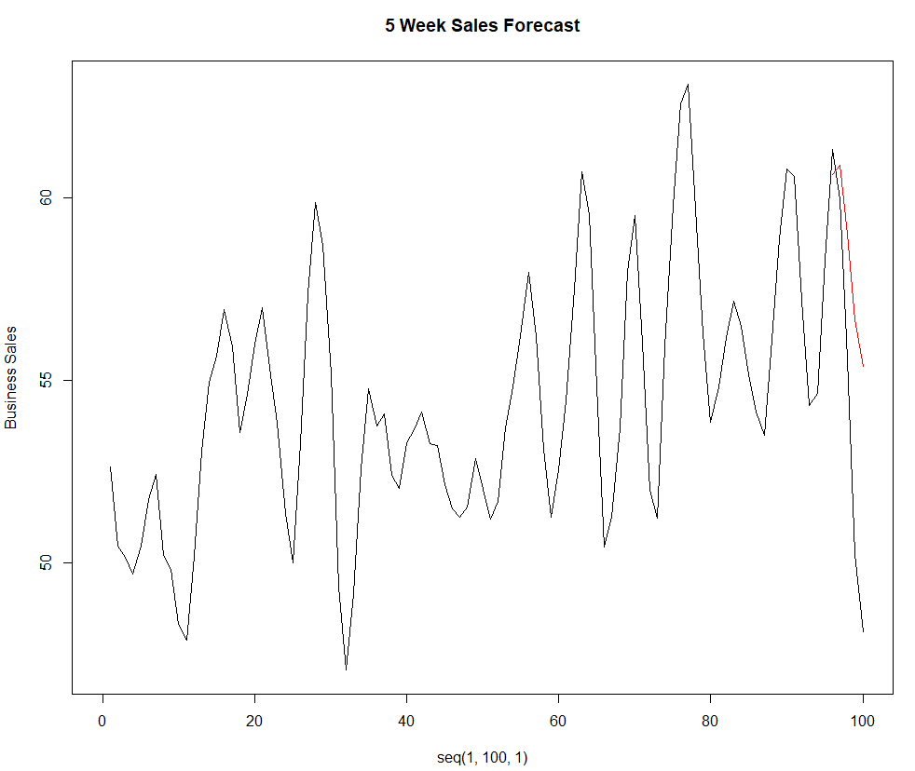
Var Model-6-trend

Slide 27
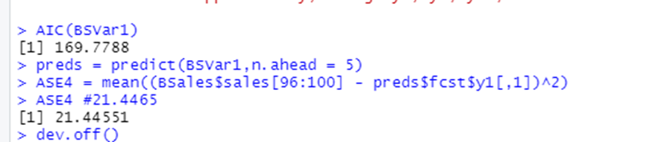
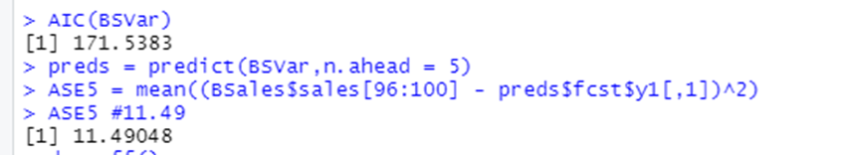
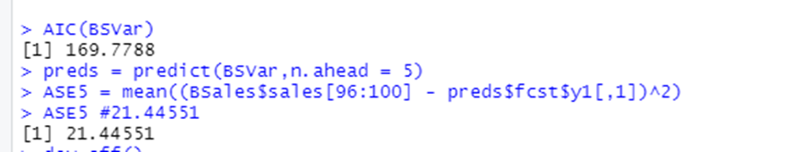
Business Sales-VAR Models Comparison
VAR | AIC | ASE | Lowest
Model4 | 169 | 21
Model5 | 171 | 11.5 | Lower/no trend
Model6 | 169 | 21.4 | trend

Slide 28
Takeaways
Primary Analysis of Business Sales Forecast with TV ,Online Advertisement with discount.
Model-1 -Initial analysis performed without trend and lag using ARIMA with 5 weeks forecast.
Model-2 -Initial analysis performed with trend and without lag using ARIMA with 5 weeks forecast.
Model-3-Initial analysis performed with trend and lag using ARIMA with 5 weeks forecast.
Forecasted Features using ARMA with /without lag and trend
4) VAR Models forecasted 5 weeks sales -with Model- 4, Model- 5 without trend, Model- 6 with trend, performance measured with AIC and ASE Values, Model 5 no trend has lowest ASE almost close AIC with others.

